Slide 1
Mission, Money, and Mentorship:
A Guide to Nonprofit Robotics Management
Lisa Marquette Porat, MSW, LCSW, FAOSW
Board Chair, FIRST Indiana Robotics
Leadership & Business Mentor, Red Alert 1741 Robotics

Slide 2

Why a Nonprofit?
Sustainable funding
Tax benefits and donor trust
Community credibility
Opens doors to grants & sponsorships
More than paperwork—it creates structure and opportunities

Slide 3

Mission, Vision, Values
Mission-driven focus: your greater why
“
”To cultivate a culture of STEAM in order to inspire future generations of leaders and innovative thinkers.”
--Red Alert 1741 Mission Statement
“We create leaders by giving students real world problems to solve, which gives them experience in more than just science and technology.”
--Red Alert 1741 Vision Statement

Slide 4
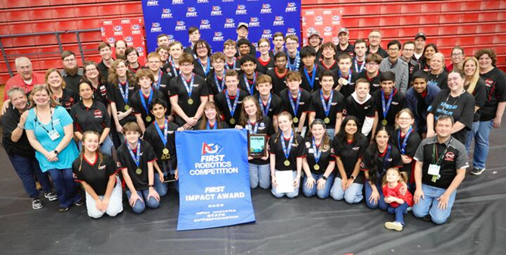
Benefits of a 501(c)3 status
501(c)(3) organizations are nonprofit groups with a dedicated mission
Why incorporate?
  Allow to apply for grants and receive donations which are tax-deductible for the donor. This includes foundations, fundraisers, sponsors, corporations and individuals
  Do not pay sales tax
  Allow for financial independence from a school (e.g. control own finances). This does not mean there is no accountability, but you are not in a reimbursement/approval situation
  Allows you to run your organization as a business entity; most robotics teams incorporate under Parent Organization

Slide 5
How to Incorporate in Indiana
Process is done through the State—Do not need attorney: Filling_Out_the_Forms_Updated_09.04.2012.ppt (live.com)
How to incorporate a Parent Organization
  Step 1: Name Your Indiana Nonprofit
  Step 2: Appoint an Indiana Registered Agent
  Step 3: Select Your Board Members and Officers
  Step 4: Indiana Articles of Incorporation
  Step 5: Draft Bylaws and Conflict of Interest Policy
  Step 6: Conduct an Organizational Meeting
  Step 7: Get an EIN
  Step 8: Get an Indiana State Tax Identification Number
  Step 9: Applying for Exemption from State and Federal Taxes (501(c)(3) status)
  Step 10: Open a Nonprofit Bank Account
  Step 11: Get Insurance for your Nonprofit

Slide 6
Governance Basics
Board of Directors
Bylaws & Policies
Separation of Roles: mentor vs. board
Accountability and sustainability
“Boards see the right things are done; mentors/coaches see things are done right”

Slide 7
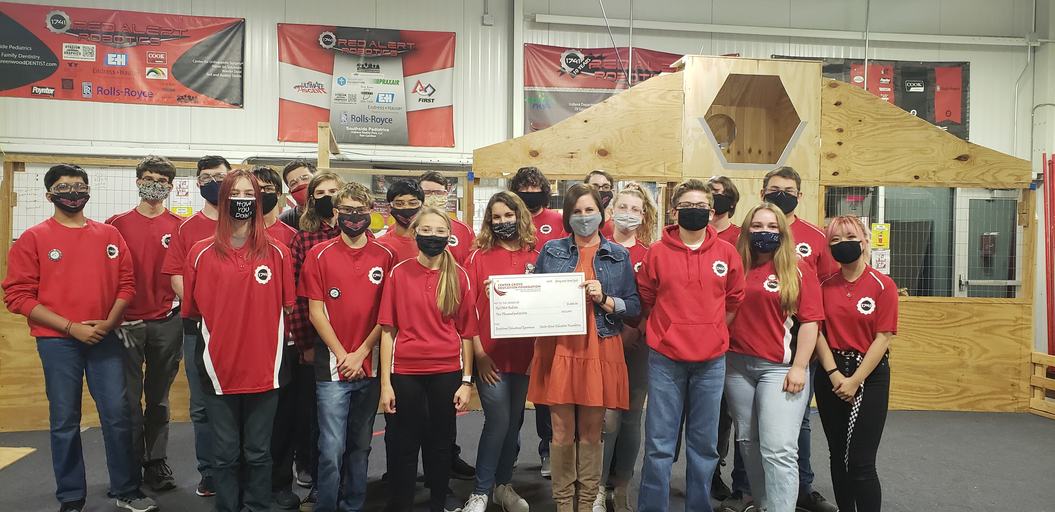
Example of Establishing Infrastructure
Red Alert Parent Organization (RARPO) and its Board of Directors run the business of the organization. Have by-laws, annual meetings, and elected officers. Parents, alumni and mentors members. Key communicators with parents
Responsible for budgeting (along with head mentors' input), expenditures, banking, tax filing, business entity reports, grants, fundraisers, dues, travel for competitions and meals
Administer student scholarship program
In conjunction with Business/Leadership Mentor--Responsible for grant writing/reporting
Provide mentorship to students on business operations (Operations Captain), community presentations, sponsor outreach and grant writing

Slide 8
Business Matters
Non-profits should be run as a business and need corporate oversight and checks and balances as well as transparency
No one person should ever control how/when/where money is taken in or spent
Recommend hiring bookkeeper to maintain continuity and reconciliation
Must file yearly taxes and business entity reporting
Keep evergreen documents centralized, including nonprofit determination letter, By-laws, EIN number, current w9 and 1099’s.
Robotics budgeting is unique in that: we don’t know the challenge for the year; what parts and equipment may be needed or need to be replaced; the size of the team varies each year; where competitions will be held—transportation costs; if make to State/Worlds. Thus,
Have to build in margins and be fluid
Create a savings account as soon as possible for Worlds travel/unforeseen expenses/lack of revenue in a season
Notes:
501(c)(3) filing & annual IRS return (U.S. teams)
Liability insurance & safety policies
Youth protection requirements
Speaker Note: Nonprofit compliance is about protecting the team, coaches, and kids.

Slide 9
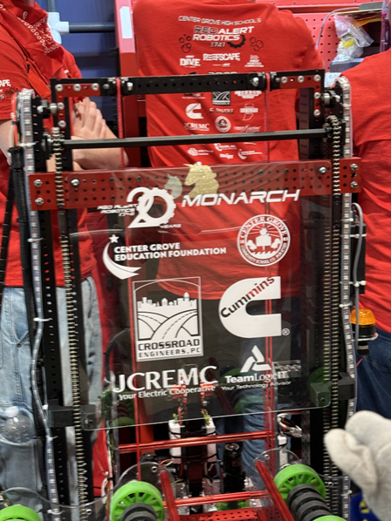

Funding & Sponsorships: Diversify
Corporate sponsors
Logo on shirts, robot, banner, demo: establish levels
Community Fundraising
Community Fundraising
Events, raffles, dine-to-donate, local business donations
Grants & Foundations
School corporation Education Foundation
Community/County Community Foundation
Private local foundations
Notes:
Bring RAR sponsorship level documents; ff letters; community donor letter

Slide 10
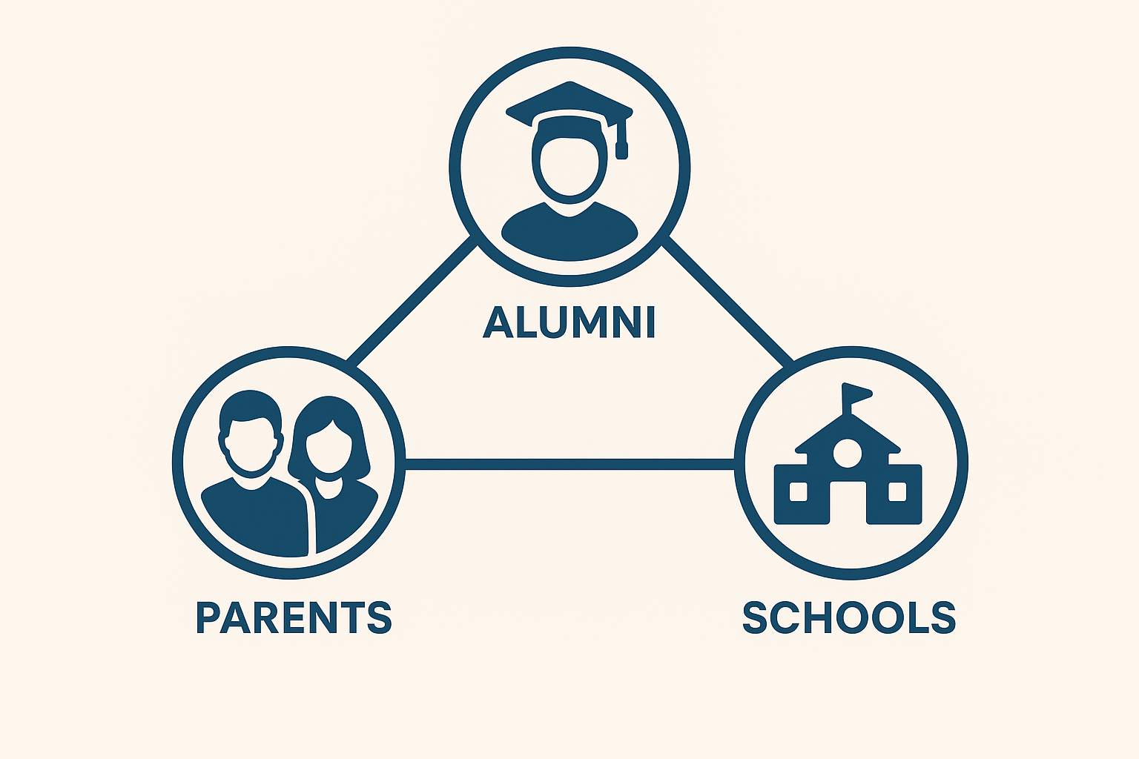
Partnerships & Community
A robotics team is stronger when connected: broaden your base
Parents as volunteers
Alumni as mentors
Local businesses & STEM orgs
Schools as partners (even if not school-based team)

Slide 11

Sustaining Growth
Mentor recruitment & training
Student leadership roles
Transition planning (coach/mentor succession)
Nonprofits thrive when leadership is shared and future-proofed

Slide 12
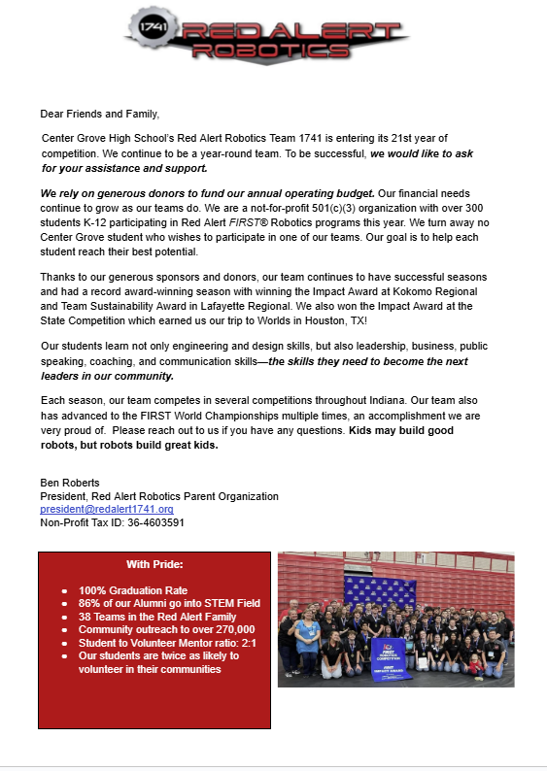
Resources & Next Steps
Sample materials
Links to FIRST Fundraising Toolkit
Numerous state-wide options Indiana Grants for Nonprofits to Explore | Instrumentl Grant Database

Slide 13

Your Questions—Your Challenges

