Slide 1
Super Class and Sub Class(Inheritance)
Example
Super Class
Pizza
Ball
Pepperoni
Pizza
Vegetarian
Pizza
Baseball
Football
Sub Class
Coach
Tree
Mrs. Shah
Mr. Campbell
Orange Tree
Apple Tree

Slide 2
Inheritance Concept
class Animal {
String color;
public void eat(){}
}
class Dog extends Animal {
String color; => Omit it
String breed;
public void bark(){}
public void eat(){} => Omit it
}
class Cat extends Animal {
String color; => Omit it
int age;
public void meow(){}
public void eat(){} => Omit it
}
Inheritance
Super Class
Base Class
Parent Class
Sub Class Child Class

Slide 3
Polymorphism
Polymorphism
Compile time Polymorphism :- Method Overloading
Run time Polymorphism :- Method Overriding
class Animal {
public void add(){
// Your Code
}
public void add(int a, int b) {
// Your Code
}
public void add(int a, int b, int c){
// Your Code
}
}
class Animal{
public void add() {
// Your Animal code
}
}
class Dog extends Animal {
public void add() {
// Your Modified Dog Code
}
}
Method Over Loading
Method Overriding

Slide 4
Methods in Java
Methods are collection of statements that are grouped together to perform an operation.
public static void main(String[] args){
int sum1=add(2,3);
Int sum2=add(4,9);
System.out.println(sum1);
System.out.println(sum2);
}
private static int add(int a, int b){
return a+b;
}
Output
5
13
public static void main(String[] args){
int sum1=2+3;
int sum2=4+9;
System.out.println(sum1);
System.out.println(sum2);
}
Output:
5
13

Slide 5
Arrays
Single Dimensional Arrays
Multi-dimensional Array
int x=5;
int y=45;
int z=27;
int a=11;
int[] myArray = [5,45,27,11];
5 | 45 | 27 | 11
Index: 0 1 2 3
Print Integer 45;
System.out.print(y);
System.out.print(myArray[1])
Output :
45
45

Slide 6
Arrays: Introduction
Arrays:
Fixed Size
Sequential collection of elements
Same data type
Index starts from 0
Index: 0 1 2 3
int []
5 45 27 11
String []
“Hello” | “Ishani” | “Shriya” | “Parina”
float []
5.0 | 8.9 | 10.1 | 2.3
Float []
5.0 | 8.9 | 10.1 | 2.3
Syntax:
datatype [] arrayName ;

Slide 7
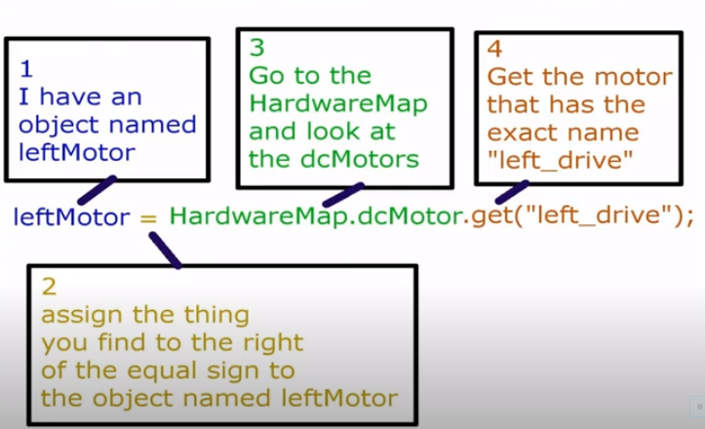
Hardware Map
It provides programmer to identify hardware in the robot so that they can write programs that interact with that hardware.
Examples of Hardware Map code is:
nameofDevice=hardwareMap.device.get(“name”);
LeftMotor = hardwareMap.dcMotor.get(“left_drive”);
servoClaw = hardwareMap.servo.get (“servo_claw”);
touchSensor= hardwareMap.touchSensor.get (“touch”);

Slide 8
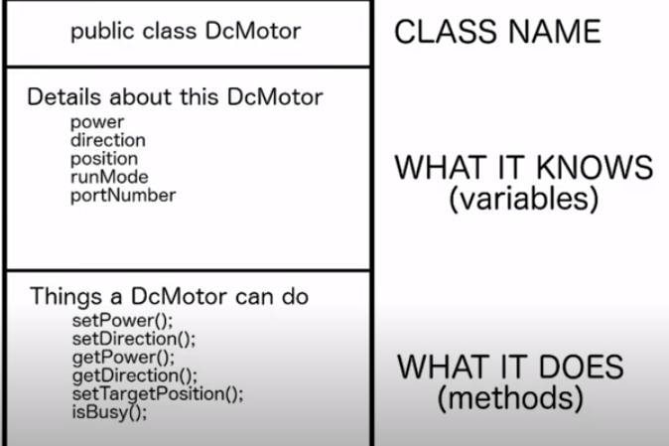
Example of DcMotor variables and Methods

Slide 9
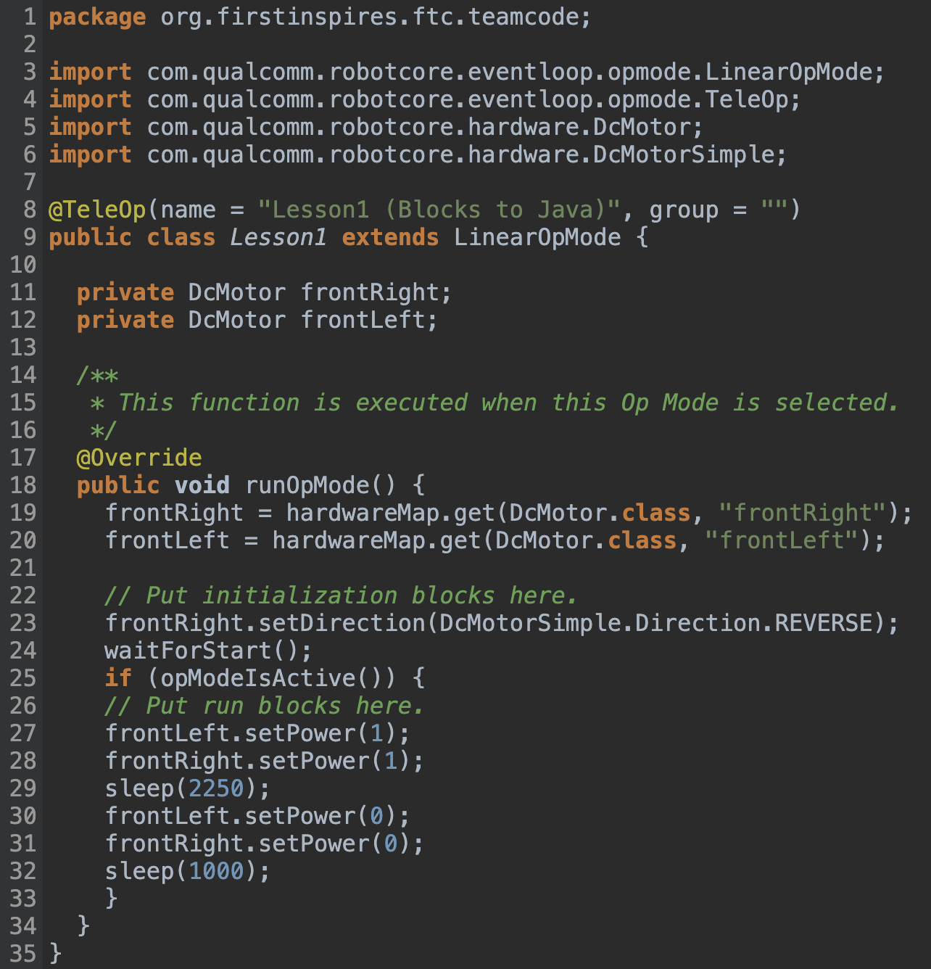
Imports
Importing the coding libraries you need
Variables
Creating variables of type DcMotor
Hardware Mapping
Linking your variables to their names in robot
configuration
Reverse the direction of right motor, So that Robot moves forward when right and left are set to 1

Slide 10
Iterators [LOOPS]
FOR Loop
WHILE Loop
DO WHILE Loop
Break and Continue Statements
System.out.println(“Hello”);
System.out.println(“Hello”);
System.out.println(“Hello”);
System.out.println(“Hello”);
FOR LOOP:
for (int i=0;i < 4; i++) {
System.out.println(“Hello”);
}
DO WHILE LOOP:
do {
System.out.println(“Hello”);
i++;
while ( i < 4);
WHILE LOOP:
While (i < 4){
System.out.println(“Hello”);
i++;
}
Loop Structure
Counter Variable
Conditional Check
Increment/Decrement the counter

Slide 11
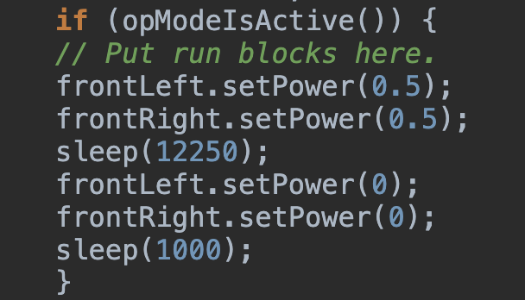
3 parts to motor movement
1. Set power for the motors causing them to move. Power values can range from 0-1.0 which changes the speed the motor moves
1.
2.
2. Wait 12.25 seconds. The sleep statement uses milliseconds so sleep(1000) means to wait 1 second
3.
Stop the drive motors by setting their power to 0

Slide 12
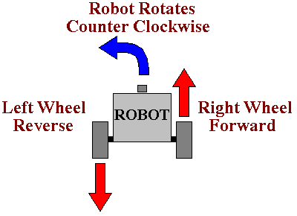
Turning or Forwards?
When both wheels move forward, the robot moves forward
When both wheels move backward, the robot moves backward
When the left wheel moves backward and the right wheel moves forward, the robot turns left
When the left wheel moves forward and the right wheel moves backwards, the robot turns right

Slide 13
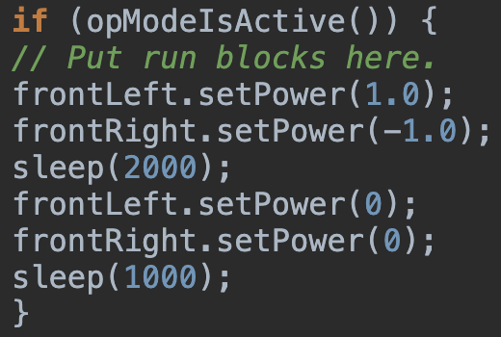
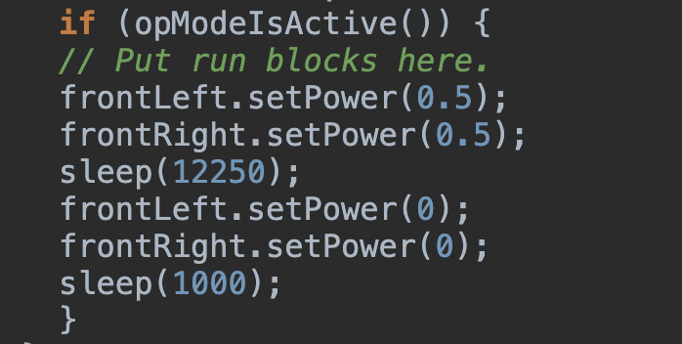
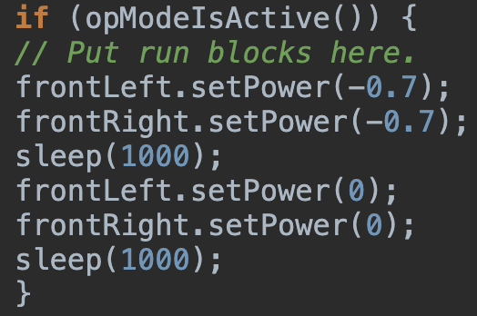
Turning or Forwards?
Turning right at 1.0 power for 2 seconds
Forwards at 0.5 power for 12.25 seconds
Backwards at 0.7 power for 1 second
Turning left at 1.0 power for 2 seconds
If (opModeIsActive()) {
// Put run blocks here.
frontLeft.setPower(-1.0);
frontRight.setPower(1.0);
sleep(2000);
frontLeft.setPower(0);
frontRight.setPower(0);
sleep(1000);
}

Slide 14
Making our own Op-Mode
Op-mode: Code that is designed to allow control over the robot.
Pair the Driver Station with the Robot Controller
Make sure you can select an op-mode
Import
public class ExampleOpMode extends OpMode
{
public void init(){
}
public void start(){
}
public void loop(){
}
public void stop(){
}
}
Create and name java class
Import the Op-Mode class and setup methods
Declare hardware
Assign hardware
Make the robot drive forward
Register the Op-mode

Slide 15
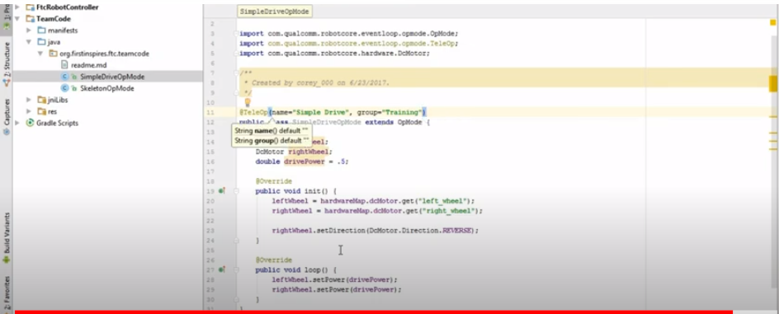
Android Studio Screen Shot

Slide 16
Types of Op-Mode
Iterative
  Continuous; looping
  Versatile
  Perfect for TeleOp game play
  Good for Autonomous play
Linear
  Sequential execution of code
  Loops can be integrated into the code (e.g., while, for)
  Not designed for TeleOp game play
  Good for autonomous

Slide 17
Important Websites for Information
One can find the details about Robotic Programming at
https://www.firstinspires.org/sites/default/files/uploads/resource_library/ftc/onbot-java-guide.pdf
Download the desire FTC app from the FTCRobotControllerGitHub repository.
Place the phone into Airplane mode will turnoff the WI-FI-radio.
Pairing the Driver station to the Robot Controller
Need to configure the robot in Robot Controller by creating Configuration File.
Need to configure all the device in Robot Controller by specifying the location of device. Ex I2C bus1, bus2 etc.

Slide 18
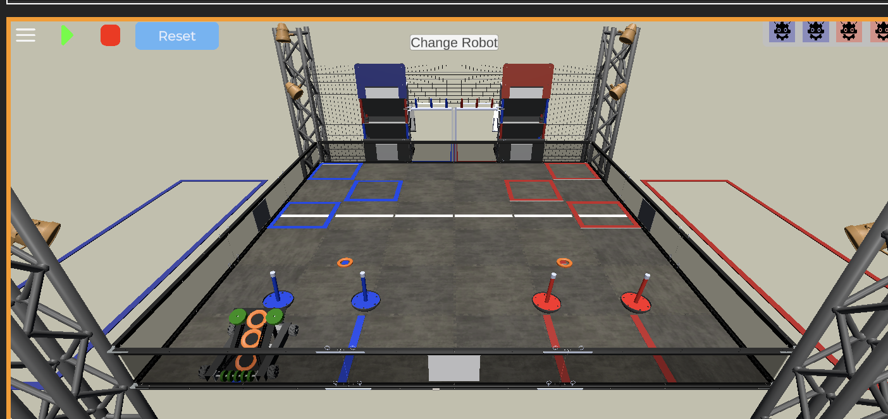
Virtual Robot
Simulator
INDEX.HTML

Slide 19
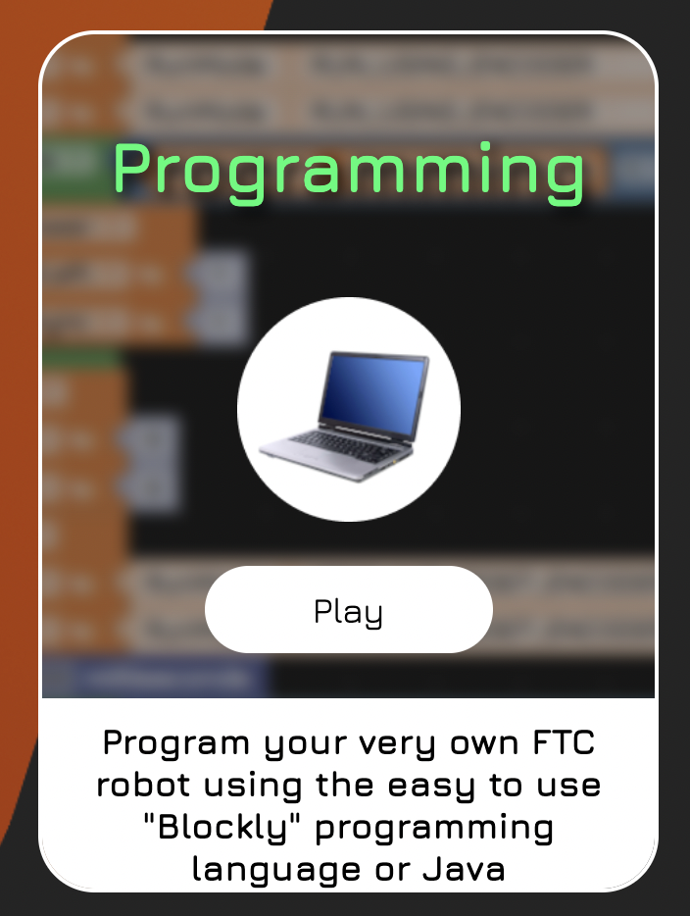
Set-Up
Go to https://www.vrobotsim.online/homepage.html
Hover over programming and select play
Follow the text guide when prompted to learn how to navigate the Virtual Robot Simulator
If there is no text guide hit the how to use button in the upper right corner

Slide 20
Quiz
1) How you define Main() method in Java?
i) public static void main(String [args]){
}
ii) public void main(String args[]){
}
iii) public static void main(string args[]){
}
iv) public static void main(String args[]){
}
Answer :- [iv]
What is a correct syntax to output :Hello World” in Java ?
i) System.out.println(“Hello World”);
ii) print(“Hello World”);
iii) Console.WriteLine(“Hello World”);
iv) echo(“Hello World”);
Answer :- (i)

Slide 21
Quiz
3) Which data type is used to create a variable that should store text?
i) string
ii) Txt
iii) String
iv) myString
Answer :- (iii)
How do you create a variable with the numeric value 5?
i) float x=5;
ii) num x=5
iii) int x=5;
iv) x=5;
Answer :- (iii)
5) Which operator can be used to compare two values?
i) ><
ii) <>
iii) =
iv) ==
Answer :- (iv)
6) Array Index starts with
i) 0
ii) 1
Answer :- (i)
7) How do you create a method in Java?
i) (method Name)
ii) methodName.
ii) methodName[]
iv) methodName()
Answer :- (iv)

Slide 22
Quiz
Which keyword is used to create a class in java?
i) className
ii) class()
iii) class
iv) MyClass
Answer :- (iii)
9) What is the correct way to create an object called myObj of MyClass?
i) MyClass myObj = new MyClass();
ii) Class myObj = new MyClass();
iii) Class MyClass = new myObj();
iv) New myObj = MyClass();
Answer :- (i)
10) In Java, it is possible to inherit attributes and methods from one class to another.
i) True
ii) False
Answer :- (i)
11) Which Keyword is used to import a package from the java API library?
i) getlib
ii) lib
iii) Package
iv) Import
Answer :- (iv)

Slide 23
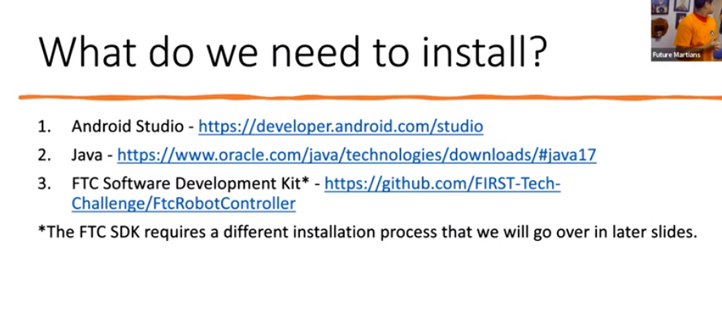
Important Links to Download latest version of Software
Android Studio
Download Android Studio
Create your GitHub Account
www.github.com
FTC Robot Controller
https://github.com/FIRST-Tech-Challenge/FtcRobotController

Slide 24
What is RoadRunner?
Motion-Planning Library
Specially developed for FTC
Autonomous period
Controls velocity & acceleration while following complex paths
Accurate & advanced paths

Slide 25
Terms to Know Using RoadRunner
Localization:
  Ability for robot to know location
  Common method – odometry (drive encoders or external dead wheels)
Motion Profile:
  Graph of a behavior which must be followed to reach a certain stage (maps out movement to reach a certain point)
    In RoadRunner – velocity of robot to reach a point
    Graph can be modified by defining max velocity, acceleration etc
Open and Closed Loop Control
  Open Loop
Not always accurate, value is sent but not sure if it will work
  Closed Loop
Feedback is given so can be modified

Slide 26
Terms to Know (cont.):
Vector2d
2D vector – (x,y) coordinate
Pose 2d
(x,y) coordinate +heading
Spline Movement
  Curved, smooth
  Change heading without making a point turn

Slide 27
Paths and Trajectories:
Paths:
  Route based on defined waypoints
  Lines, splines, etc.
  Trajectories:
  Paths with motion profiling
.forward()
Moves robot forward
.back()
Moves robot backwards
.strafeLeft()
Moves robot left
.strafeRight()
Moves robot right
.strafeTo() & .lineTo() & .lineToConstantHeading()
Moves robot to specified coordinates while keeping the same heading
Functions for Trajectory

Slide 28
Functions for Trajectories
.lineToLinearHeading()
  Moves robot to specified coordinates linearly while changing the
start -> end heading
.lineToSplineHeading()
  Moves robot to specified coordinates in a spline movement while changing the
start -> end heading
splineTo()
  Moves robot to specified coordinates in a spline movement while following tangent heading

Slide 29
ADB Connection to connect Android Studio to Control hub wirelessly
Go to Control Panel
Go to System and Security
Go to System
Go to Advance System Setting at the bottom
Click on Environmental Variable
Double Click on Path
Click on New
Write Path C:\Users\shahj\AppData\Local\Android\sdk\platform-tools
Press Ok and restart Android Studio
Go to terminal and type adb . If you don’t get error than adb is connected
User name is different for different laptops

Slide 30
PIDF Implementation to hold Arm at certain Position

