Slide 1

FTC Programming Tutorial

Slide 2
Name : Mrs. Shah Profession: Freelancer on Fiverr and Upwork as a WordPress Web-Developer Robotic Coach Website: www.jaiminishah.com

Slide 3
What is Flowchart
Computer algorithms could be represented using Flowchart
(also known as Flow Diagram) and Pseudocode.
Flowchart is a graphical or visual representation of an algorithm.
Flowchart uses formally agreed standard symbols connected by lines with arrows to show the flow of the algorithm.
Flowchart is easier to read and understand.

Slide 4
Parts of a Flow Chart
Start/End
Indicates starting point or ending point of the flowchart or algorithm.
Input/Output
Indicates input to or output from the process within the algorithm.
Process
Indicate the process or operation that is performed within the algorithm.
Decision
Indicates the selection or decision within the algorithm.
Yes
No
Logical Flow of the Algorithm

Slide 5
Flow Chart
Definition
A flowchart is a schematic representation of an algorithm or a process.
Check Dog’s Bowl
Is it Empty?
Start
Pour Food into Bowl
Stop

Slide 6
Example
Count from 1 to 9 by odd numbers.
Before attempting to draw the flowchart, determine what you want the output to be.
What is the First Block

Slide 7
Step1
Step 3
Now that there is a number, the program will state the number.
The output will be 1,3,5,7,9.
The Start block is always first.
Start
Start
INPUT 1
Step 2
SAY NUMBER
The program begins with number 1
Start
Input 1

Slide 8
Step 4
START
The number 2 will be added to 1 so that the program will continue to count by odd numbers.
Add a decision block so that the program will continue counting until the value is greater than 9.
Once the number is greater than 9, the programs ends
INPUT 1
SAY NUMBER
ADD 2
Is number > 9?
No
YES
STOP

Slide 9
Algorithm
Pseudo Code
A pseudo code is a compact and informal high-level description of a program.
An Algorithm is the step-by-step procedure to solve the problem.
How would you login to Canvas?

Slide 10
Algorithm to log in to your facebook account
Go to school site
Click on Canvas
Enter Student ID and Password
Click on Log in button

Slide 11
Algorithm and Flow Chart to Add 10 and 20
Initialize sum=0 (PROCESS)
Enter the number (i/o)
Add them and store the result in sum (PROCESS)
Print sum (i/o)
Start
Sum=0
Enter 10,20
Sum=10+20
Print sum
Stop

Slide 12
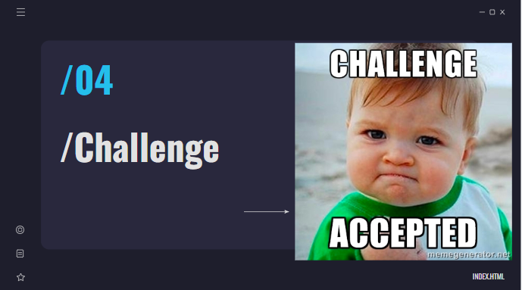

Slide 13
Write Algorithm and Draw a Flow Chart to Find Sum of 5 Numbers

Slide 14
Find the sum of 5 numbers
Algorithm in simple English
Initialize sum=0 and count =0 (PROCESS)
Enter n (I/O)
Find sum+n and assign it to sum and then increment count by 1 (PROCESS)
Is count <= 5 (DECISION)
If YES goto step 2
Else
Print sum (I/O)
Start
Sum=0
Count=0
Enter n
Sum=sum+n
Count=count+1
Is count <= 5
Print sum
No
Yes
Stop

Slide 15
SDK, IDE and FTCRobotController
SDK (Software Development kit)
A “kit” of programming tools
IDE (Integrated Development Environment)
A word-processor for coding, a debugger, and a compiler all in one.
Android Studio:
An IDE for coding with Android devices
Ftc App Master :
A SDK written by FIRST and Qualcomm made to run FTC robots
Android Studio – https://developer.android.com/studio
Java SDK (optional since Android Studio includes it) –
https://www.oracle.com/java/technologies/downloads/#java17
FTC Software Development kit* - https://github.com/FIRST_Tech_Challenge/FtcRobotController
Game Manual Zero
https://gm0.org/en/latest/index.html
Resource Document
https://ftc-docs.firstinspires.org/index.html

Slide 16
Java – Compiling and Running code
After a Java source file (example: "Test.java") has been created, it needs to be compiled. The compiler compiles the code in that file to generate a Bytecode file ("Test.class"). This is done using the "javac" command of the Java Software Development Kit (Java SDK)."javac Test.java"compiles it to create Test.class
This bytecode file can be executed on any platform (Operating System - OS), but it cannot simply be run on the OS.
Execution of the bytecode ("Test.class" file) requires an interpreter which will convert the bytecode instructions to instructions for the OS to execute "java Test“ runs the bytecode Test.class
The JVM (Java Virtual Machine) is the interpreter that can run the bytecode generated after compilation, by interpreting it into machine level instructions for the OS.

Slide 17
Java Object Oriented Programming
Classes
Blueprint for an object
Defines Data variable
Defines methods
An object is an instance of a Class
Types of Classes
Public
Private
Example of Main Method
public static void main( String args[]) {
}
public, static = access modifier
void = returns nothing
String = Data type
args[]= argument
class Arm1{
Arm1 a1=new Arm1();
}

Slide 18
Abstract Keyword
Abstract Class:
A class that is declared abstract
You cannot create object of abstract class
It may or may not contain abstract
methods
Abstract Method:
No method body. You cannot write
code in abstract method.
It is mandatory to override the
abstract method in child class
abstract void printStatus();
abstract class A {}

Slide 19
Types of Classes
Abstract Class
It is declared using “abstract” keyword
It contains abstract method which don’t have body
It contains concrete method which has body
It can’t be instantiated
Concrete Class
Can be made into an object or interface (i.e., instantiated)
Superclass – A base class
Subclass – An extended class

Slide 20
Types of Variables
Boolean: True or False
integer: 32 bit signed whole number
long: 64 bit signed whole number
floating point: 32 bit decimal value
double floating point: 64 bit decimal value
String: array of characters
DcMotor
Servo
Examples of variable declarations:
DcMotor leftDrive
DcMotor rightDrive
Servo clawArm
TouchSensor touch

Slide 21
Java and Variables
Define a variable name b and set its value to 20
Define a variable name c and set its value to 10
int b=20;
int c=10;
telemetry.addData(“B”,b)
telemetry.addData(“C”,c);
telemetry.updata();
When you define a variable in Java you must set its type. These variables are whole numbers which is the integer type. The other common variable types are Strings which are text variables and floats which are decimal numbers
telemetry.addData(“Caption”, Value);
It takes two parameters
1) Caption : A string that describes the data
2) Value: The data itself, which can be any object.
telemetry.update
After adding all the data, you need to call
telemetry.update() to push the values to the driver station screen.

Slide 22
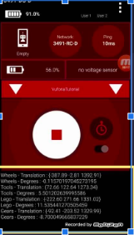
What is Telemetry
Telemetry lets us communicate with our robot
Telemetry sends real-time data from the robot to the driver station
By displaying values of arm-position, speed of motors, sensors data which helps in monitoring and controlling the robot effectively
Where telemetry gets displayed when using a real-life robot

Slide 23
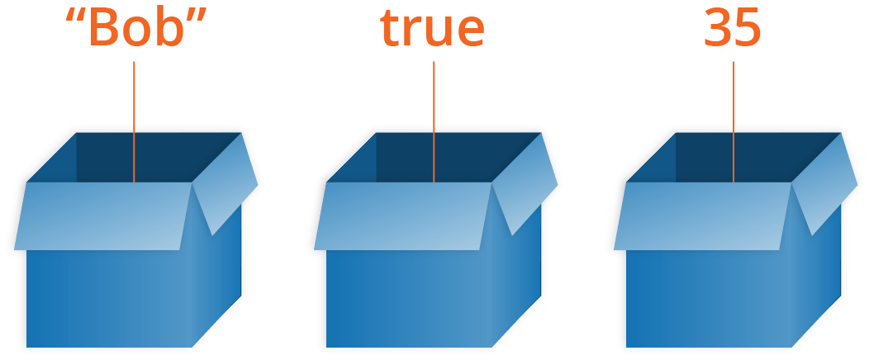
What is a variable?
Way to store information for later use
Can store strings, numbers, boolean and other types of data
You name a “box” in the computer memory and put something inside the box
When you use the name of the box you reference the data you stored inside
Name = Bob b =true Age=35
Name
b
Age

Slide 25
Write a program to display addition of two numbers.
Hint : Use ( “System.out.println”) to display the result.
class Addition {
int a=1;
int b=3;
int result= a+b;
public static void main (String args[]) {
System.out.println(“The addition of two numbers is:”+result);
}
}
Compile : javac Addition.java
Run : java Addition
It will create a java.class file.
On screen :
“The addition of two numbers is 4”

